Slide 1
Shihtzu vs Butterfly Who is more viscious

Slide 2
Shihtzu Temperament
1. Shih Tzus are generally known for their friendly and affectionate nature.
2. They are relatively small dogs, usually weighing between 9-16 pounds.
3. This breed is known to be sociable and good with families, yet they can exhibit stubbornness.
4. Though Shih Tzus can have a sense of territorial defense, they are not typically known to be aggressive or vicious.

Slide 3
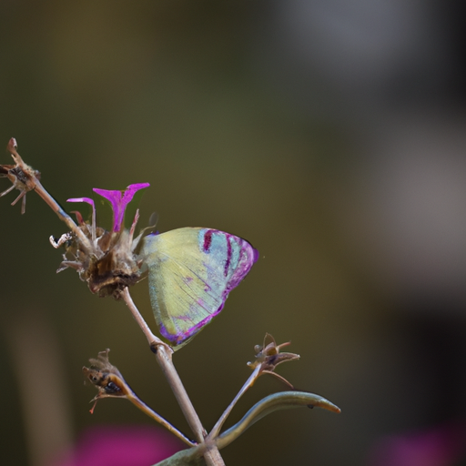
Butterfly Behaviour
1. Butterflies are gentle and delicate insects, known primarily for their colorful wings and harmless behaviors.
2. They do not possess the anatomical features necessary to defend aggressively, such as teeth or claws.
3. Butterflies primarily focus on feeding on nectar and have a life span that centers around metamorphosis and pollination activities.
4. They pose no threat to humans or larger animals and are generally considered symbols of peace and transformation.

Slide 4
Thanks for Watching

